Slide 1
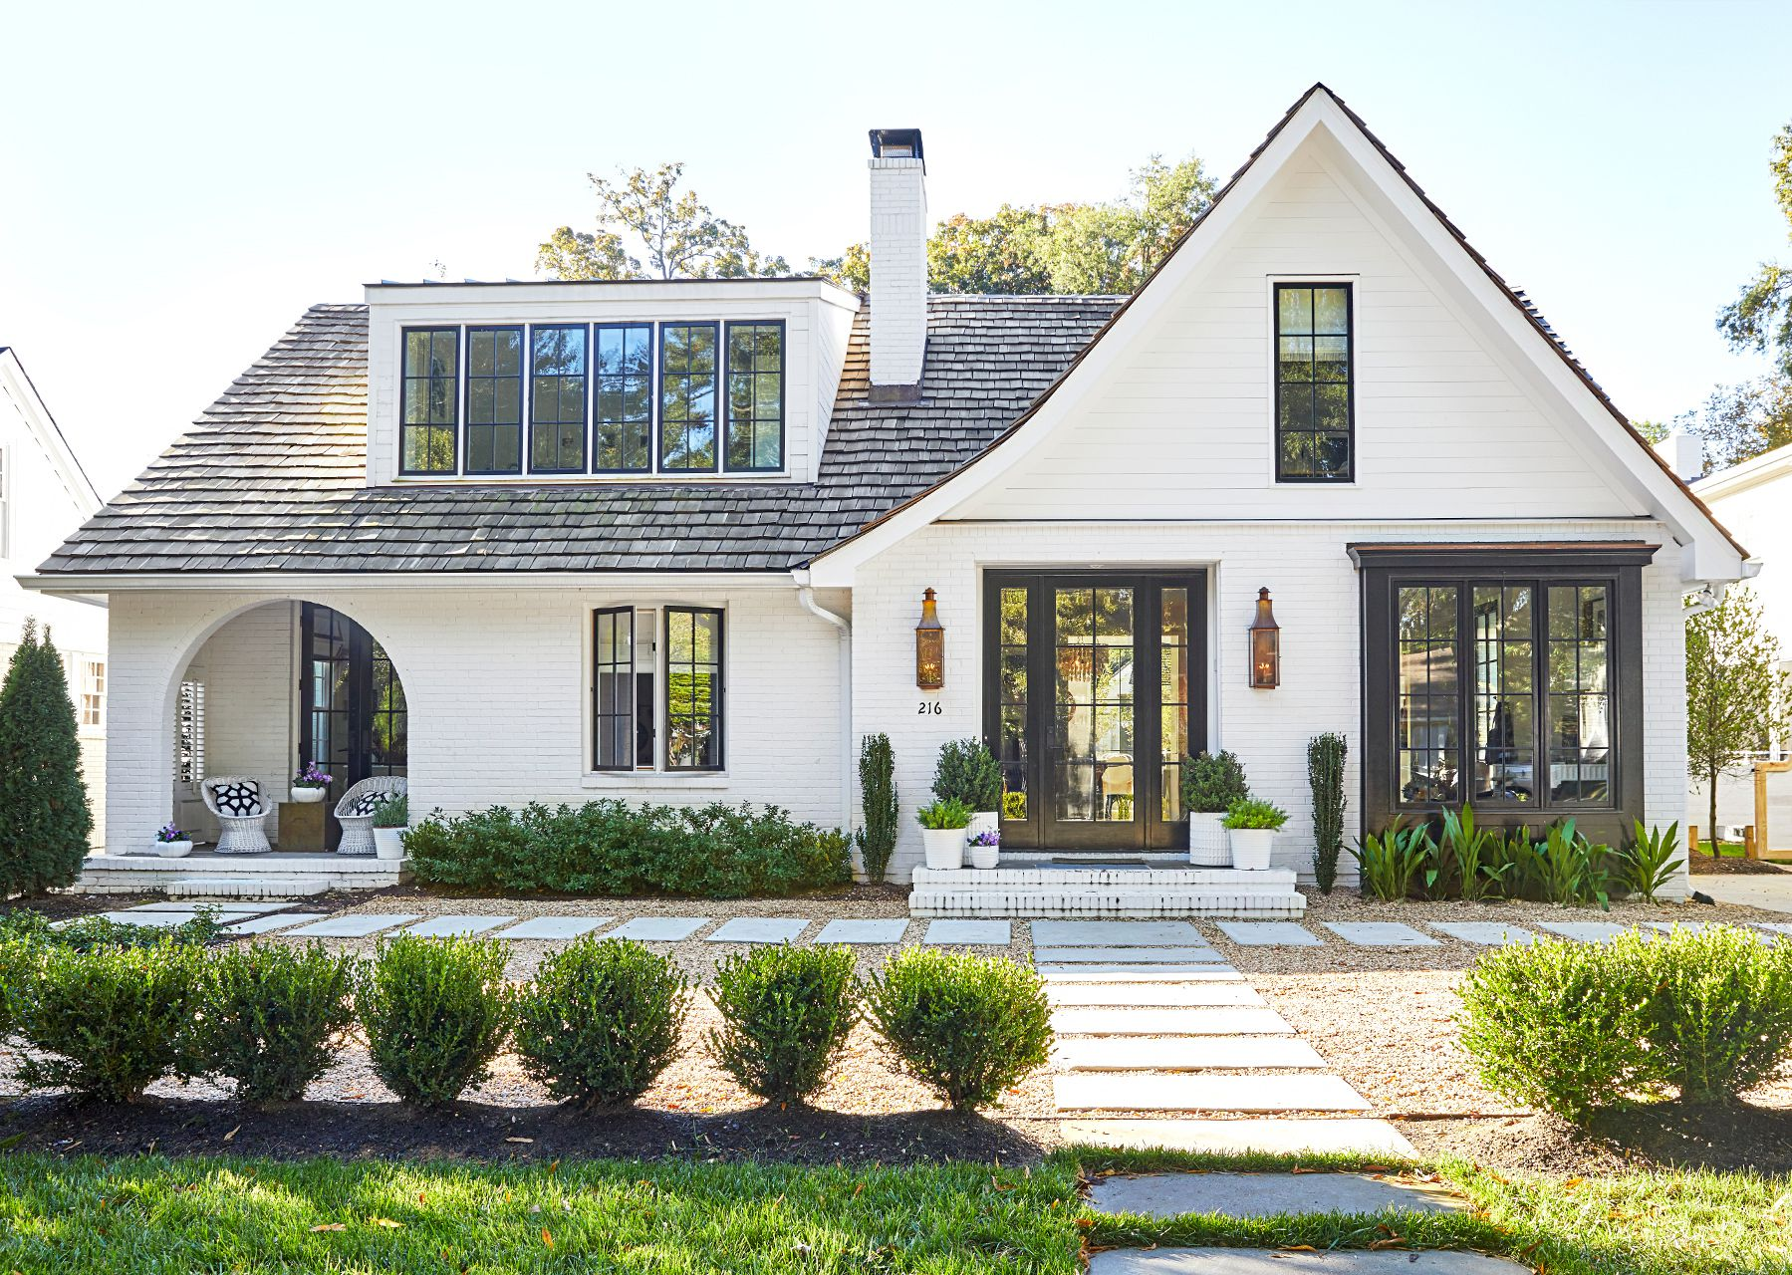
Real Estate Price Data Analysis
Tom Rush
Image: https://www.bhg.com/home-improvement/exteriors/curb-appeal/house-styles/

Slide 2
Data Distribution
Total Houses: 1460
Most Expensive Sale: $755,000.00
Least Expensive Sale: $34,900.00
Houses were sold between 2006 and 2010
Notes:
To gain insight into which aspects of homes contribute to the highest selling price, we must first understand the dataset that we are given.
This dataset contains information on 1,460 homes. The price range of the homes is between $34,900.00 and $755,000. The oldest sale was in 2006, and the most recent sale was in 2010.
In this analysis we need to find out which aspects of the homes contribute to the highest sell price. This way we can find the areas of the house that we need to remodel to increase the sales price.

Slide 3
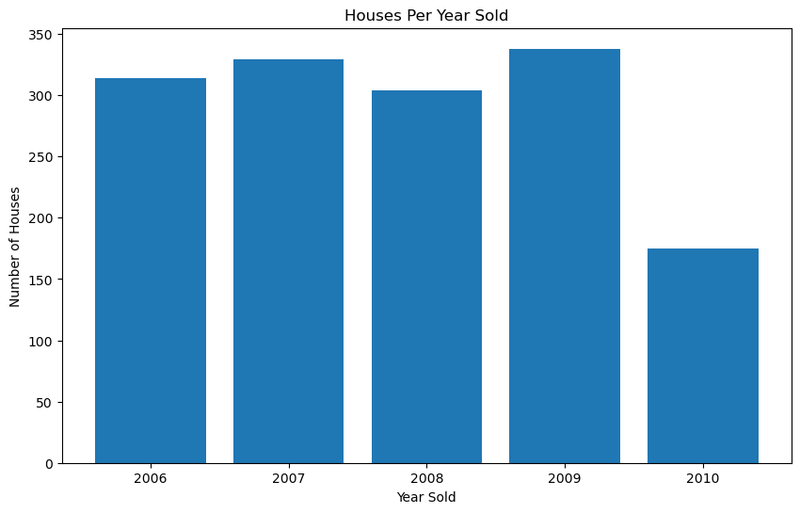
Houses Sold vs. Year
Notes:
This bar graph displays the number of homes sold in each year.
As we can see from the graph the year with the most homes sold is 2009. If we were in 2010 or 2011, we would want to remodel our homes and get them on the market as quickly as possible, since more people are buying homes.

Slide 4
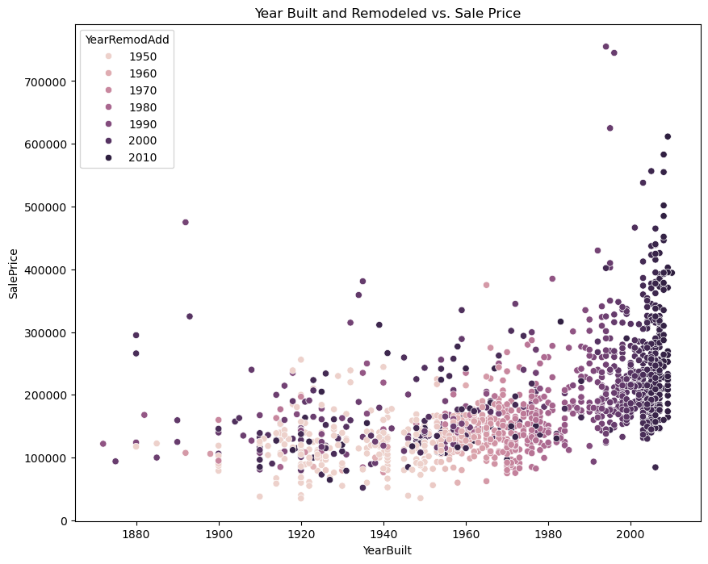
Comparing Construction Year to Remodel Year
Notes:
Here is a scatter plot comparing the year built and the year renovated against the sales price.
This scatter plot is extremely effective since it displays the relationship between three variables.
The dots with the darker color were renovated more recently. These darker color dots are generally higher in the plot than the lighter color dots meaning that the more recent the renovation, potentially, the higher the sales price.

Slide 5
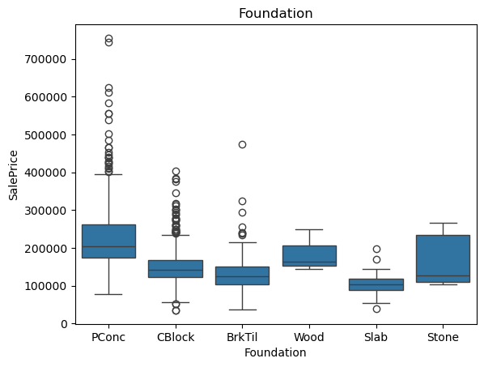
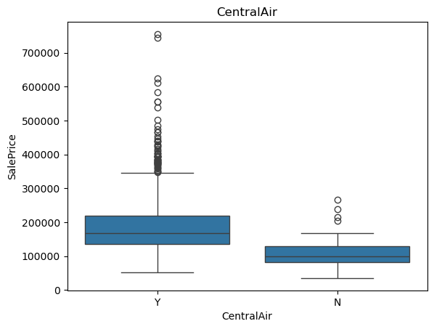
Categorical Features of the Dataset
Notes:
These box plots describe the most influential categorical features of the dataset.
These categories are the most influential toward sales price because each type of foundation corresponds to a higher or lower sales price. This can be inferred from the graph because each box is on a different level of the graph.
This is the same for Central Air. Houses with central air have a higher median sales price than houses with no central air.

Slide 6
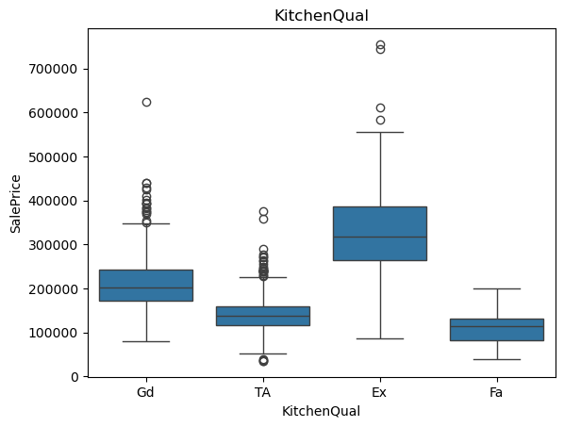
Categorical Features of the Dataset
Notes:
Like the first two box plots, the Kitchen Quality type greatly influences the sales price.
As we can see from the box plot, the houses with an excellent kitchen quality have a larger sales price than houses with good, fair, or unknown kitchen prices.

Slide 7
Variable Transformations
Central Air
Y
N
Y
Dummy Variables
CentralAir_Y
1
0
1
CentralAir_N
0
1
0
Notes:
To use CentralAir, Foundation, and KitchenQual in my analysis, I had to transform the data into numerical values that could be used in regression.
The method that I used was dummy variables. This creates a column for each outcome of the categorical column I am working on. For example, CentralAir has two possible outcomes, yes and no. The dummy variable created a yes column and a no column for each house. It inserts a 1 in the column if the outcome applies to the house, and it inserts a 0 if the outcome does not apply to the house.
This method allows me to be able to use categorical columns in my regression analysis.

Slide 8
Variable Transformations
SalePrice
100000
150000
200000
Log(SalePrice)
11.512
11.918
12.206
Log Transformation
Notes:
Another variable transformation that I used in my regression analysis was the natural log of the sales price instead of the sales price itself.
I did this to avoid autocorrelation in my regression model. Autocorrelation means that different housing sales price values will start to relate to each other over time, which is detrimental to the regression model's prediction accuracy.
The graphs on the next slide will demonstrate the affect of transforming our sales price variable.

Slide 9
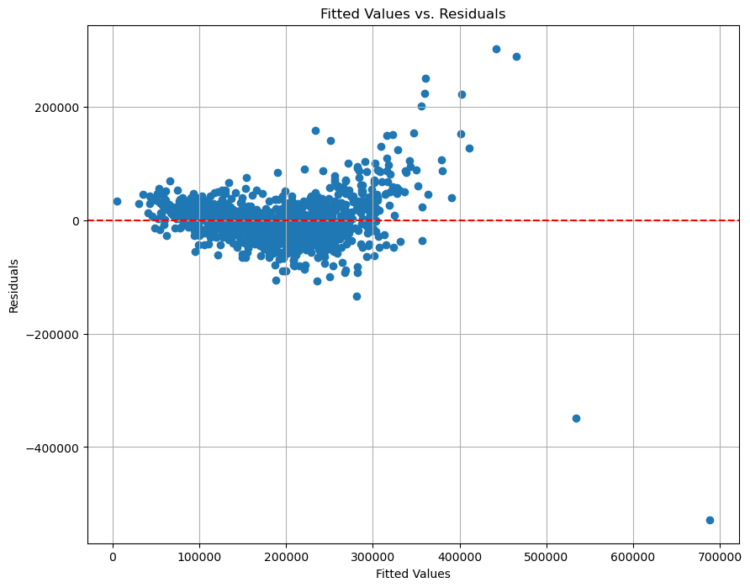
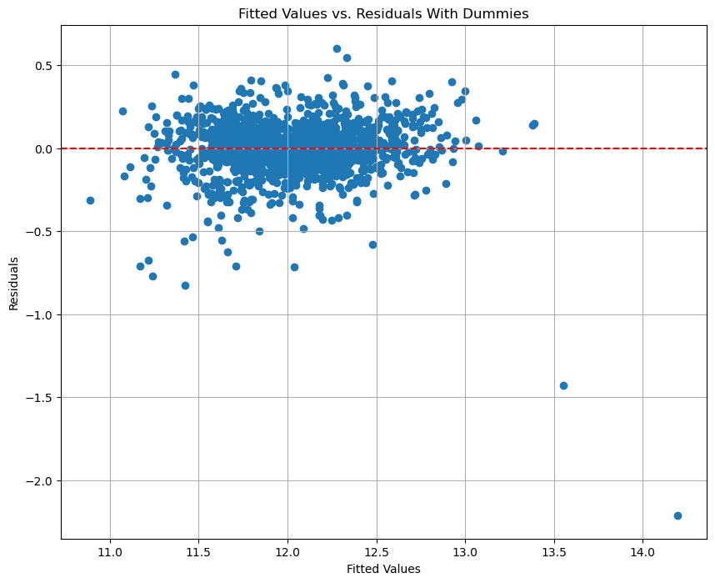
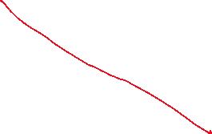
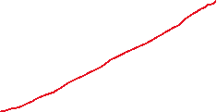
Variable Transformations
Notes:
The graph on the left is before we did a log transformation. We do not want this regression result graph to have a cone shape (which I highlighted in red).
The graph on the right is after we did a log transformation. It does not have a cone shape, and all the values are randomly placed on the plot with no relation to one another.
The graph on the right will give us the most accurate model for our predictions.

Slide 10
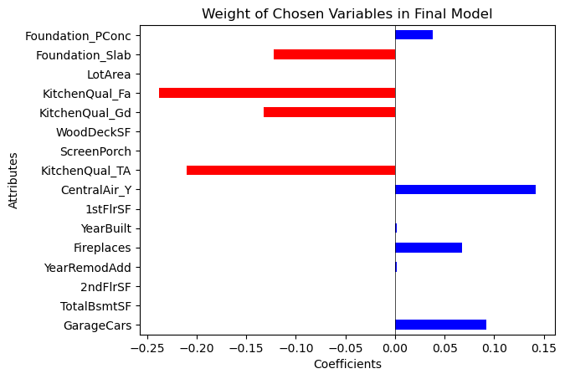
Regression Model Key Findings
Final Model R Squared Value: 0.824
Notes:
The R-squared value is a measure of how effective the model is at predicting new house sales prices. It ranges from 0 to 1 where 1 is perfect and 0 is not effective.
0.824 is an extremely good R-squared value which means our model will be good at predicting house sales prices.
The graph on the right shows the most important variables used in our regression. The variables that correspond with the blue bars positively impact the sales price of a house, and the variables with the red bars negatively impact the sales price of a house.
The next slide will show recommendations based on these influential variables.

Slide 11
Recommendations Based on Coefficients
Houses with Central Air are highly sought after and contribute most to increasing the sales price.
A house with a garage that can fit many cars will cost more.
Both Year Built and Year Remodeled will have a similar effect on sales price.
A house with more fireplaces will be more expensive.
A house built with a foundation made of concrete will sell at the highest price.
Notes:
Here is what I suggest you should do to increase housing sales prices.

Slide 12
Predictions
House 1: $161,418.99
House 2: $161,297.03
House 3: $212,537.00
House 4: $351,299.30
House 5: $111,633.53
Notes:
Here are the prediction prices of the five houses that were given using the regression model.

